Slide 1

Problem Statement and Team Details
Problem Statement:
Team Name:
Team Leader Name:
Institute Name:
Team Leader Email ID:
CFO Helper Agent
Algorithm
Paladi Raga Amrutha Ratna
KL University H
pramrutha700@gmail.com

Slide 2
Problem and Solution
Problem Statement:
Managing finances is hard for small businesses and startups, as users struggle to predict the impact of hiring, spending, or price changes, while Excel and static reports remain slow, error-prone, and fail to provide actionable insights.
Solution:
Quickly simulates budget scenarios to show the impact of hiring, spending, or price changes.
Provides clear forecasts with easy-to-understand charts for better financial planning.
Explains results in plain English so anyone can understand the outcomes.
Updates calculations automatically when new financial data arrives.
Allows users to generate and share simple reports for informed decision-making.

Slide 3
Methodology & Implementation
The solution uses a web-based dashboard and AI assistant with scenario controls for monthly spending, product price, and team size to simulate financial outcomes.
Backend integrates with live APIs (Pathway and Flexprice) to fetch real-time subscription payments and billing data to keep forecasts up-to-date.
Financial forecasts (cash balance, revenues, expenses) over six months are visualized in charts, with key metrics like runway and profitability clearly displayed.
Users can export reports and share scenarios to facilitate collaboration.

Slide 4
Technology Used
Frontend: HTML5, CSS3, JavaScript (ES6+) with responsive design and user-friendly UI
Visualization: Chart.js library for interactive financial charts and real-time stock visualization
AI Integration: OpenAI GPT-4.5 Turbo API for intelligent financial insights and chatbot
Document Generation: jsPDF library for exporting financial reports in PDF format
API Integration: RESTful APIs (Railway, RapidAPI) for live data and billing systems
Development Tools: Node.js with HTTP server for local development and backend integration
Implementation: Object-oriented JavaScript with ES6 classes and modern web standards

Slide 5
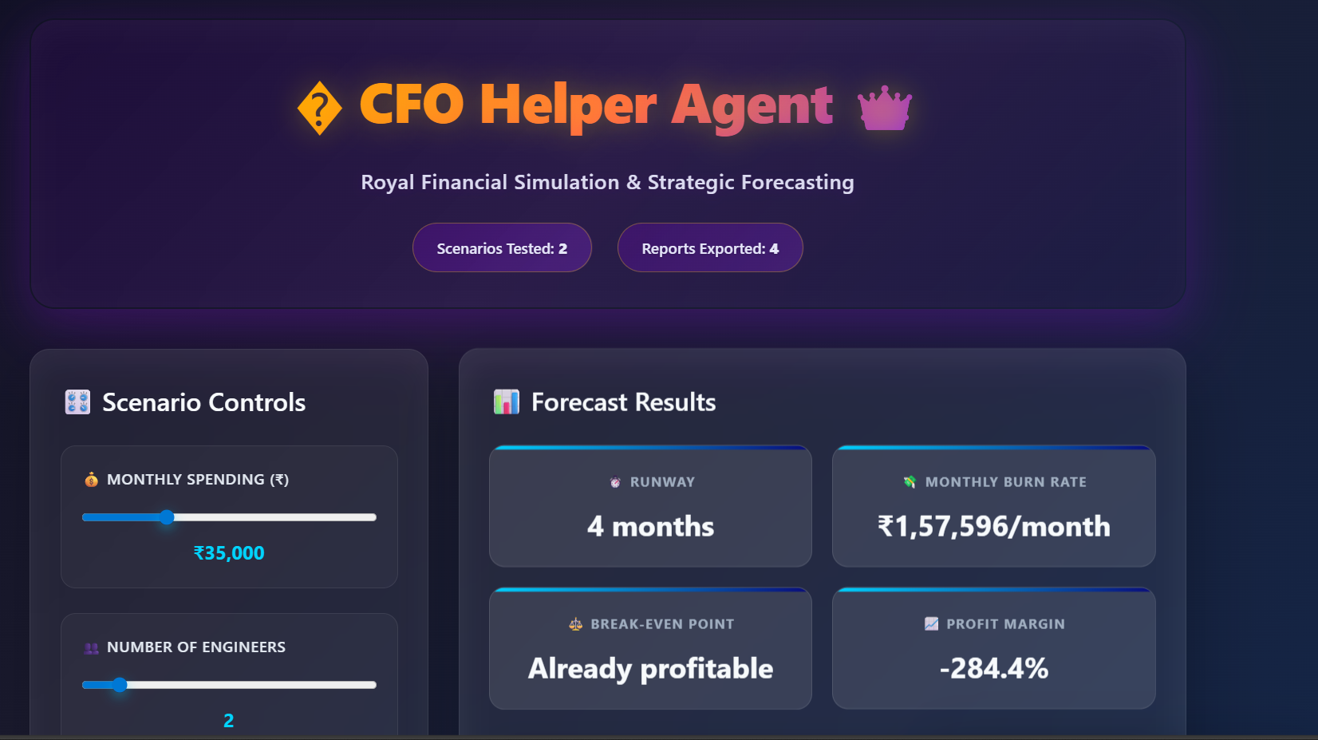
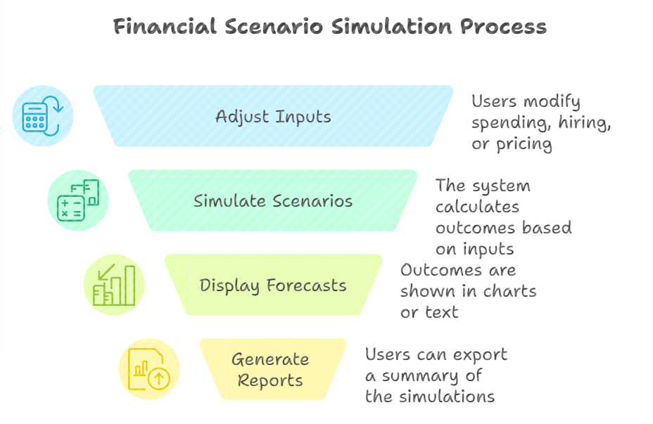
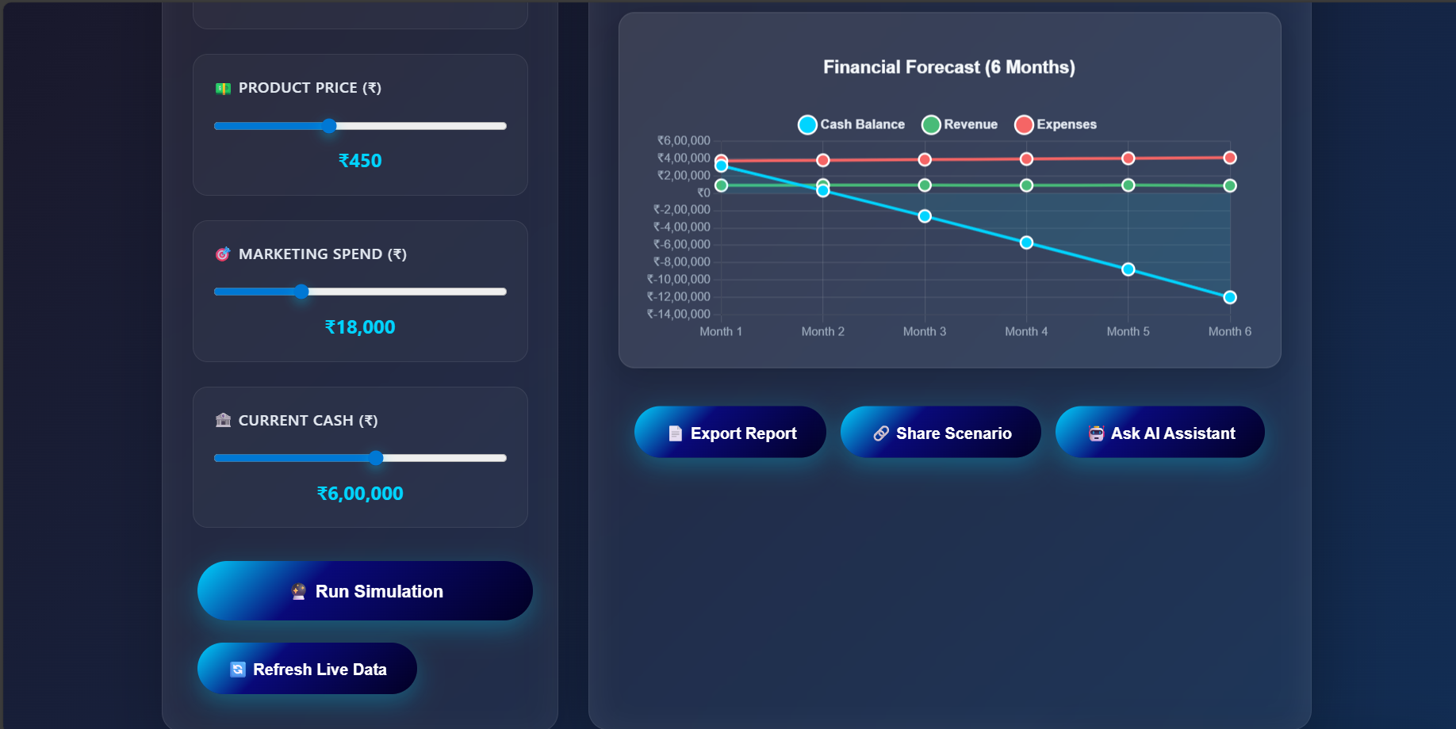
Flowchart & Supporting Images
Supporting Images
Flowchart

Slide 6
Feasibility and Market Use
This tool targets CFOs, finance managers, and startups needing rapid financial forecasting without complex spreadsheets or manual analysis.
With live API integrations and scenario simulations, it supports agile financial planning in fast-changing markets.
The solution can be extended to include additional data sources, deeper analytics, and integration with accounting systems, making it scalable and commercially viable.

Slide 7
GITHUB REPO LINK
https://github.com/Amrutha-77/Algorithm_CFO-Helper

Slide 8
Conclusion
The CFO Helper Agent presents a transformative approach to financial planning and budgeting by enabling dynamic scenario simulation, real-time data integration, and actionable forecasting.
This tool addresses the common challenges faced by CFOs in managing complex and rapidly changing financial landscapes by providing clear insights on cash flow, runway, and profitability with interactive visualizations and detailed reports.
By empowering finance teams to make faster, data-driven decisions, the project not only enhances operational efficiency but also reduces financial risks and supports strategic agility.
With its scalable architecture and live API connections, the CFO Helper Agent has strong potential for adoption by startups and established companies alike seeking modern financial management solutions.
This project stands as a practical, innovative contribution to simplifying and improving CFO-level decision-making processes.

Slide 9
THANK YOU
TEAM MEMBERS:
PALADI RAGA AMRUTHA RATNA – 2320030355
CHERUKURI SAI DEEKSHITA – 2320030278
GULLAPALLI SHEETAL – 2320030092
RAVURI BRAMHANI – 2320030104
KUMMARI HEMANTH KUMAR – 2320030150
ALLARI MUKESH KUMAR – 2320030463

